Slide 1


Bank of Baroda Hackathon - 2022
Technology Partner
Your Team Name :Lens King
Your team bio : We are accomplished as coder and programmer, we are ready to use our skills to contribute the exciting technological advances.
Date :

Slide 2
Problem Statement
VIDEO ANALYTICS
We already know about, what are the issues facing in the banking sector under the video analytics field.
As we have an idea about these issues, we are ready to solve the given problem statement.
Our project is to turn the surveillance camera into an autonomous sensor for real time alerts, changing the method of real time video monitoring.
Activity detection is a major problem in smart videos surveillance. It is a fundamental problem in a computer vision to detect the activity of human in surveillance videos.
These applicants need real-time detection performance but it is generally consuming to detect actual activity .

Slide 3
User Segment & Pain Points
The following segments which cuold be early adapters are
Sentiment analysis and feedback for false positives.
Count of people.
Identification of known facilitators.
The pain points of our product are
Tampering with the cameras.
Time taken for a activity on premises.

Slide 4
Pre-Requisite
The competitive products that we needs:
Video Footage Quality for clear recognition.
Video Management System ( VMS) to support video content analysis.
Graphic Processing Unit (GPU) to transform video content into actionable intelligence.
Digital Twin that enhance the retrieval of the large multimedia data (3D - Image processing ).
High Performance Computing (HPC) - this drives data analytics and subsequent data.

Slide 5
Azure tools or resources
Azure Video Indexer portal: Let us evaluate the product, manage the account, and customize models.
API integration: All of Azure Video Indexer's capabilities are available through a REST API, which let us integrate the solution into our apps and infrastructure.
Embeddable widget: Let us embedded the Azure Video Indexer insights, player, and editor experiences into our project.

Slide 6
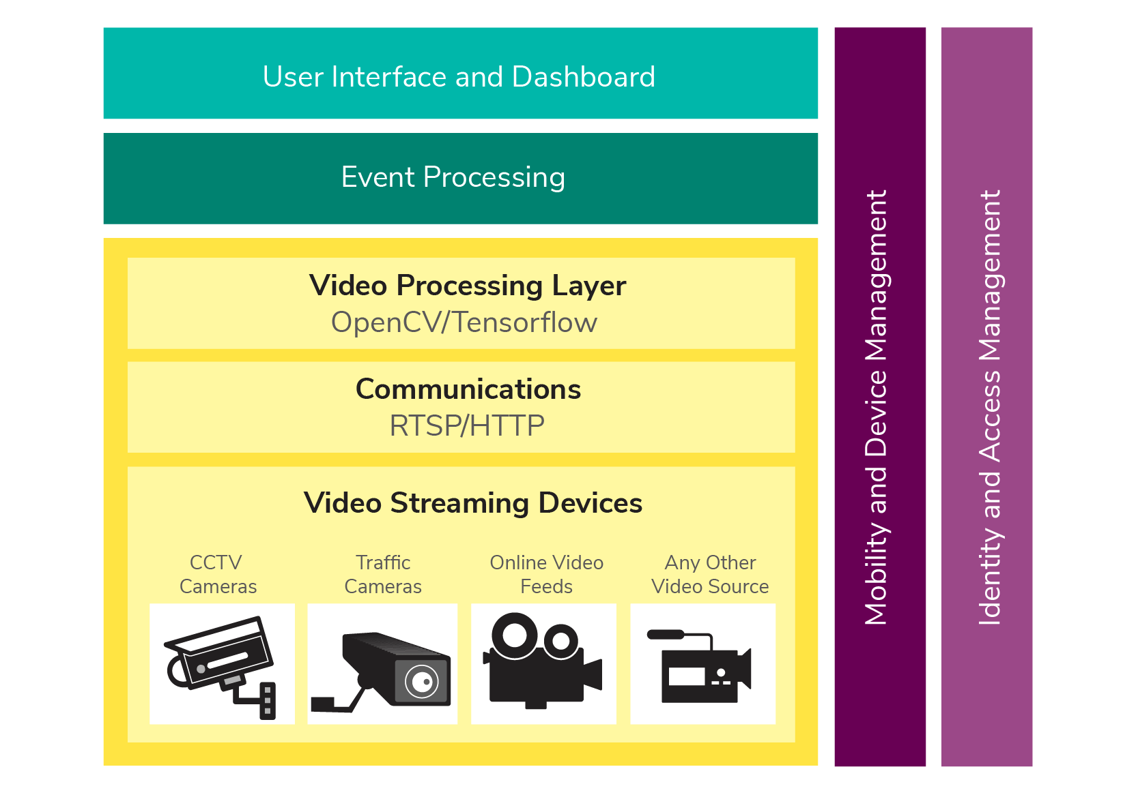
Any Supporting Functional Documents
User Interface and Dashboard - Monitor the activity , health , size of images / video library, all in one place. Get real time reports on videos , users, servers and more.
Event Processing - The process that takes events or streams of events , analyzes them and takes automatic action and event that can be specifically recorded.
Video Processing Layer - It grabs video streams from video streaming devices such as CCTV cameras , online video feeds , or any other video source using Real-time Streaming Protocols (RTSP) or HTTP.

Slide 7
Key Differentiators & Adoption Plan
Describe below are the breif use – adoption plan of video analytics in the workplace.
Video Analytics for face recognition - It is a method of identifying an unauthorised person or verify specific person’s identity from their face.
Video Analytics for behaviour detection - It’s a method to detect the person’s behavior towards the property of bank organization.
Video Analytics for person tracking - It start with all possible detections in a frame and give them an ID for the people tracking.
Crowd detection with video analytics - Crowd scenes have many people accumulated with frequent and heavy closure, many existing detection, tracking, and activity recognition technology which are only applicable to sparse settings, do not work well in crowded location.

Slide 8
GitHub Repository Link & supporting diagrams, screenshots, if any

Slide 9
Thank You
Team members :
HARSHINI V.S
JANANI G.K
GOWTHAMARAJ . R
JANANI . A

